Slide 1
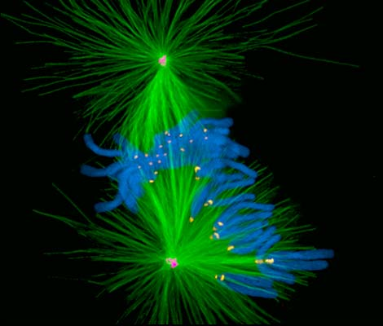
Fluorescence Microscopy Kurt Thorn NIC

Slide 2
Why fluorescence?
High contrast
Signal against dark background
Highly specific, multi-color labeling
GFP etc.
Antibodies
Live imaging
GFP etc.
Quantitative
Sensors for [Ca], pH, …

Slide 3
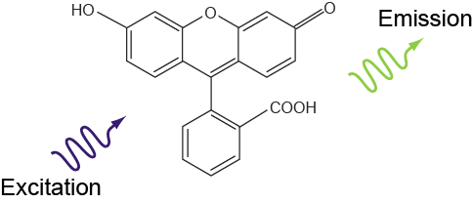
What is fluorescence?
Emission light is longer wavelength (lower energy) than excitation light

Slide 4
Jablonski diagram
(Molecular energy diagram)
Singlet states
Spin S=0
S₂
S₁
λ_{em}
λ_{exc}
Lifetime
τ ~ 1–4 ns
fluorescence
S₀

Slide 5
Jablonski diagram
(Molecular energy diagram)
Singlet states
Spin S=0
Triplet states
Spin S=1
S₂
T₂
S₁
λ_{em}
T₁
λ_{exc}
Lifetime
τ ~ 1–4 ns
fluorescence
S₀

Slide 6
Jablonski diagram
(Molecular energy diagram)
Singlet states
Spin S=0
Triplet states
Spin S=1
S₂
T₂
Inter-
systems
crossing
S₁
T₁
Lifetime
µs–ms
λ_{exc}
λ_{phospho}
S₀
phosphorescence

Slide 7
Singlet and Triplet States
Orbital states of each electron
Spin flip
Lowest unfilled orbital
λ_{exc}
Highest filled orbital
Total spin S=0
Singlet state
Total spin S=1
Triplet state
Spin flips are “dipole forbidden” → unlikely → long triplet lifetime

Slide 8
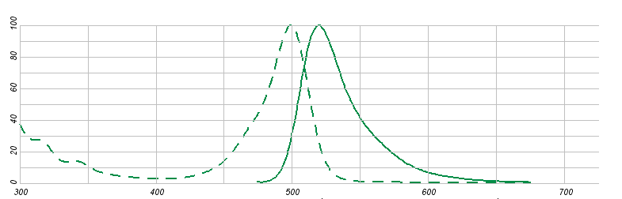
Fluorescence Spectra
Excitation
maximum
Stokes shift
Emission
maximum
Alexa 488

Slide 9
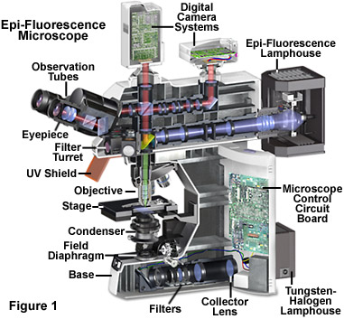
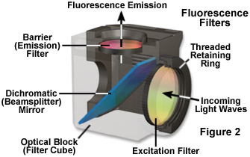
The Epifluorescence Microscope

Slide 10
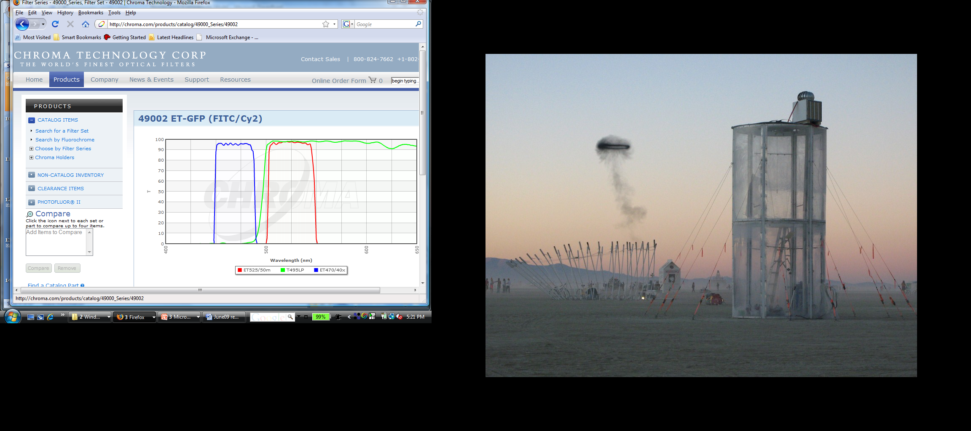

Slide 11
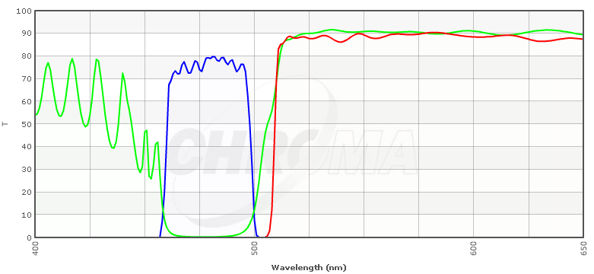
Bandpass
Longpass

Slide 12
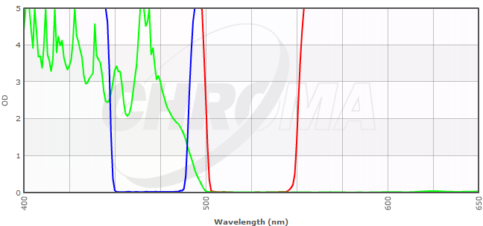
%T
OD
= -log₁₀(%T)

Slide 13
Interference filters
Interference
→ Wavelength-
Dependent
transmission
& reflection
→ filter
n₁
n₂
n₃
n₄
n₅
n₆
n₇
n₈
Filter makers : Chroma
Semrock
Omega

Slide 14
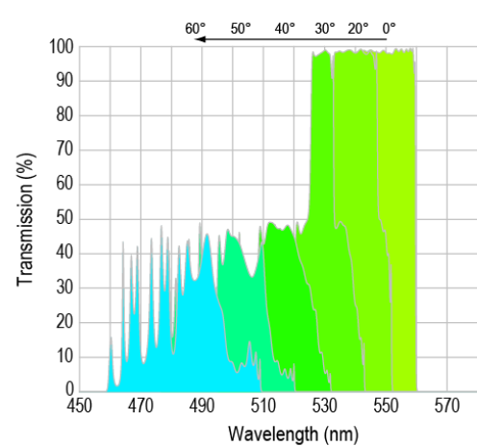
Filter spectrum is angle dependent
Generally bad
Semrock

Slide 15
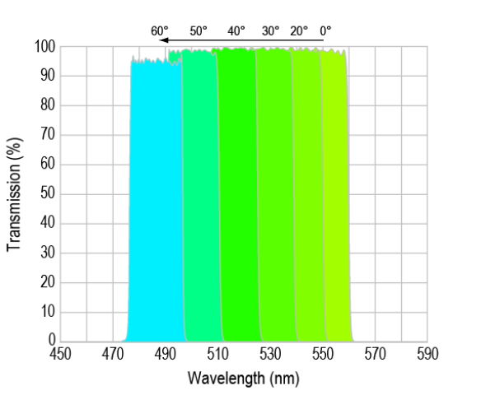
Filter spectrum is angle dependent
But can be good – Semrock VersaChrome
Semrock

Slide 16
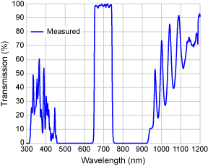
Blocking
Interference filters have finite stop bands
Unblocked bandpass interference filter
100%
Transmission
Exc.
pass
band
Stop
band
Pass
band
Stop
band
λ
Semrock 697/75
To block unwanted transmission from UV to IR, filter makers add
absorption glass to the filter.
Often excitation filters are blocked,
but emission filters unblocked.
Red autofluorescence or room light
may get through your blue emission filter
UV absorber
Interference filter
IR absorber

Slide 17
Filter cube nomenclature
Chroma labels filters as center wavelength / passband (e.g. D350/50x)
Dichroics are labeled by cut-on wavelength (e.g. 505DCLP)
Nikon filters use a letter to specify illumination wavelength – e.g. UV, B, G, R
Letters afterward specify emission profile – e.g. UV-2A vs UV-2E/C

Slide 18
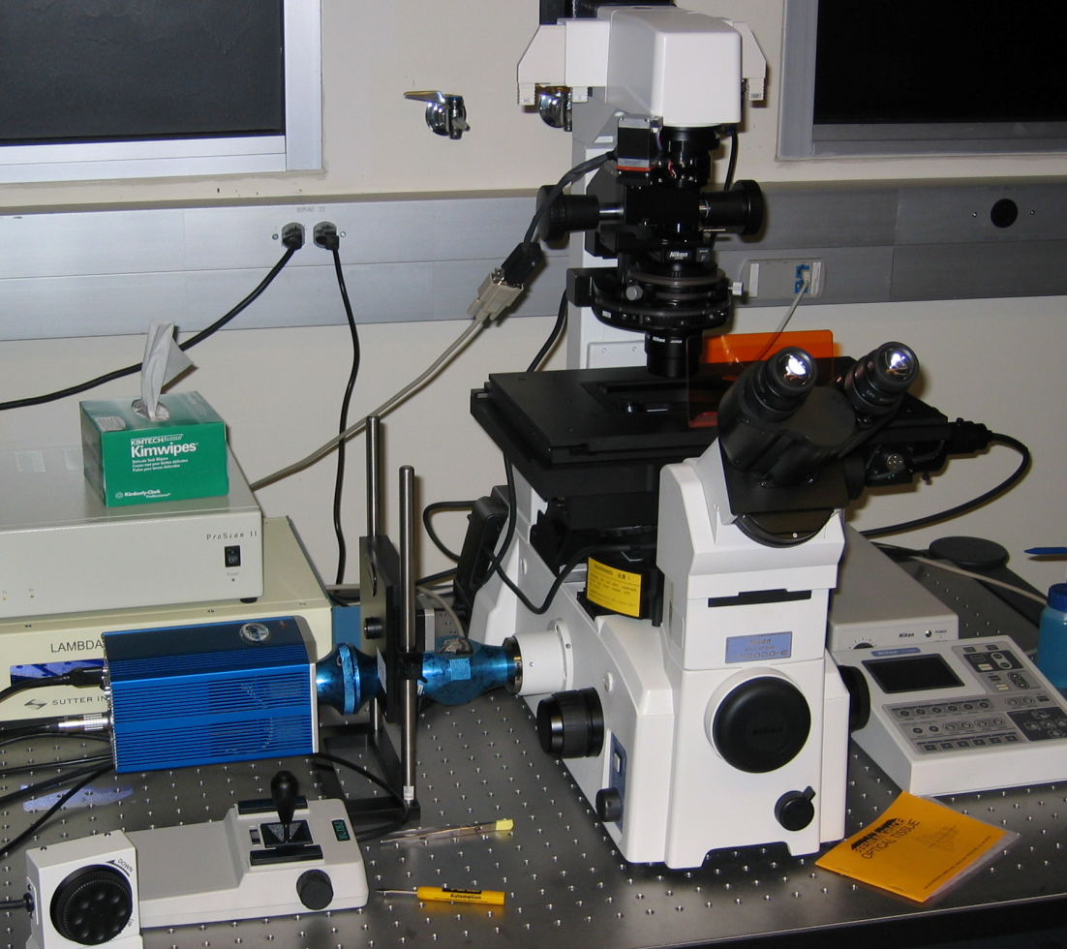
Exploding the filter cube
Emission Filter
Dichroic Mirror
Excitation Filter (off slide)

Slide 19
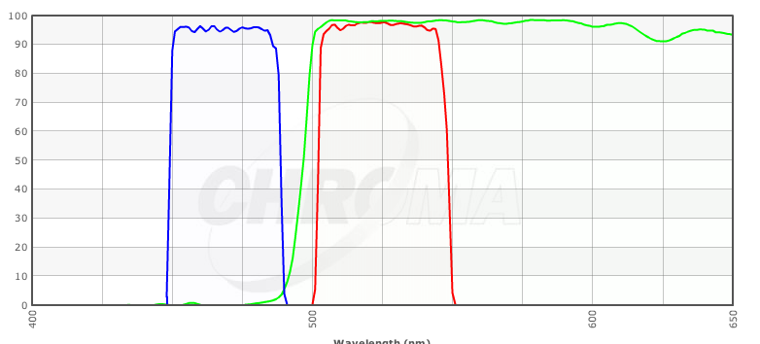
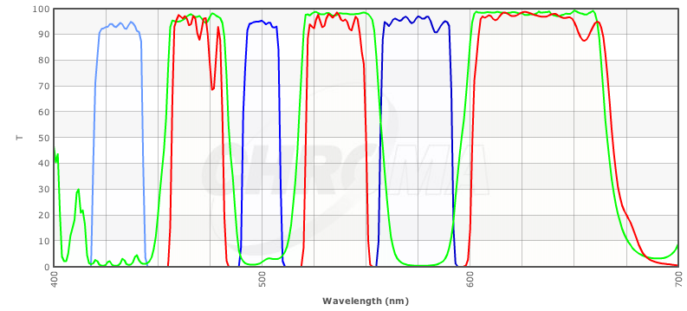
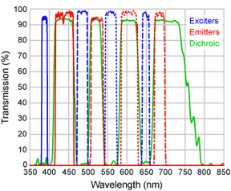
Filter schemes
Single wavelength sets
Most efficient
Best separation
Very slow to change λ
Transmission
Multi-band filters
Multi-band everything
See all colors at once
For color cameras
Bad crosstalk
“Pinkel” scheme
Multi-band dichroic
Multi-band emitter
Single-λ exciters
Excitaton filter wheel
Separate image at each wavelength
Better separation
“Sedat” scheme
Multi-band dichroic
single-band emitters
Single-λ exciters
Two filter wheels
Even better separation
Wavelength
Chroma triple Pinkel set
Semrock quad Sedat set

Slide 20
Light Sources
Arc Lamps
Hg and Xe
Metal Halide
LEDs
Plasma
Lasers
Generally only for collimated illumination (Confocal, TIRF)

Slide 21
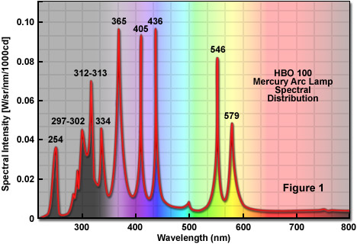
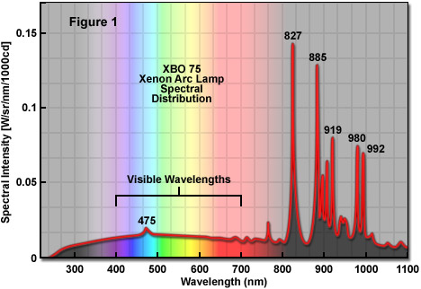
Arc Lamp Spectra
Hg: Brighter if your excitation spectrum matches one of the lines
Xe: More stable, longer lifetime, flat emission in visible is sometimes beneficial

Slide 22
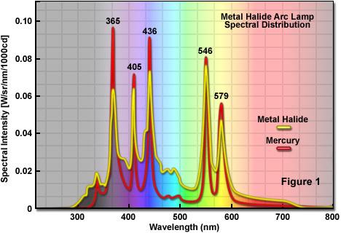
Metal Halide Arc Lamp
Exfo, Intensilight, etc.

Slide 23
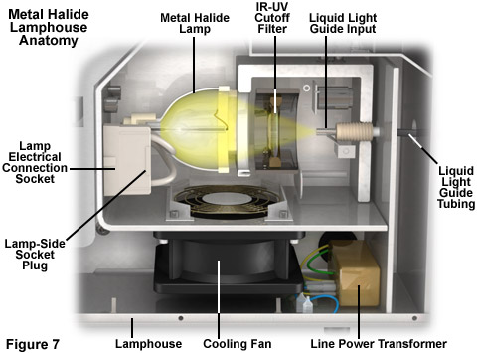
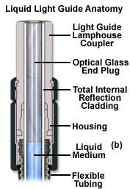
Metal Halide Arc Lamp

Slide 24
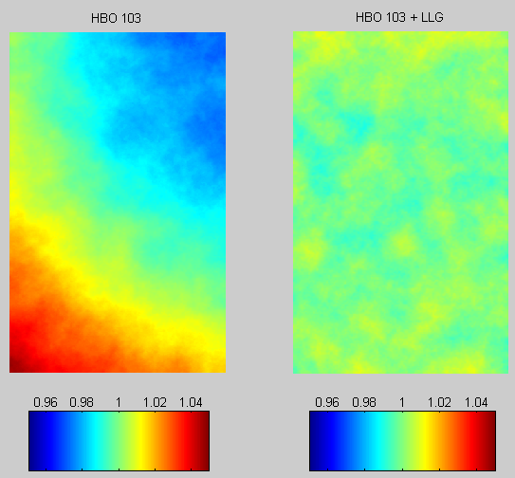
Benefit of Liquid Light Guide
Improved Illumination Uniformity

Slide 25
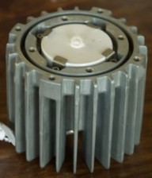
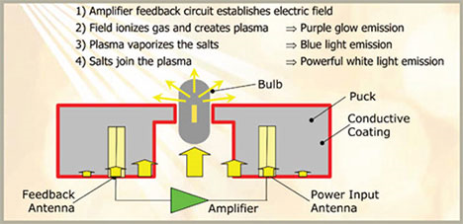
Plasma Lamp
LIFI; Sutter XL
Electrodeless ‘arc’ source
Very bright
10,000 hr life

Slide 26
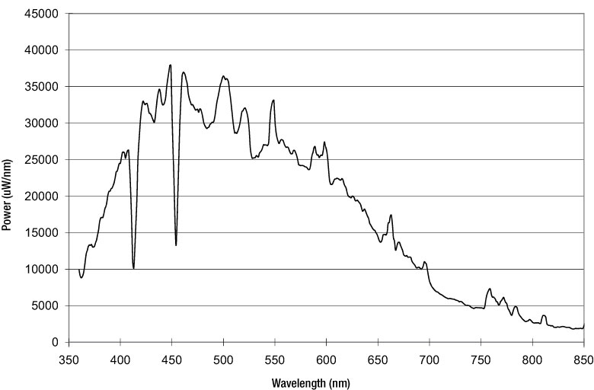
Plasma Lamp
LIFI; Sutter XL

Slide 27
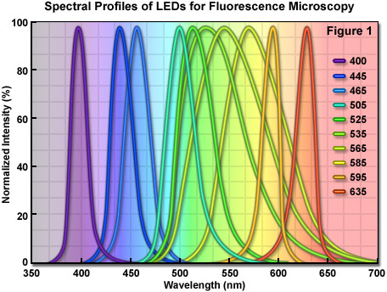
LEDs
Good in the blue / red
Not so good in the green / yellow
Long lifetime
Fast switching

Slide 28
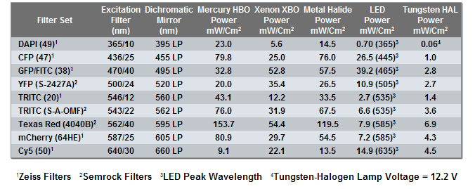
Relative lamp power
Summary: Metal Halide best; LEDs still not quite bright enough.

Slide 29
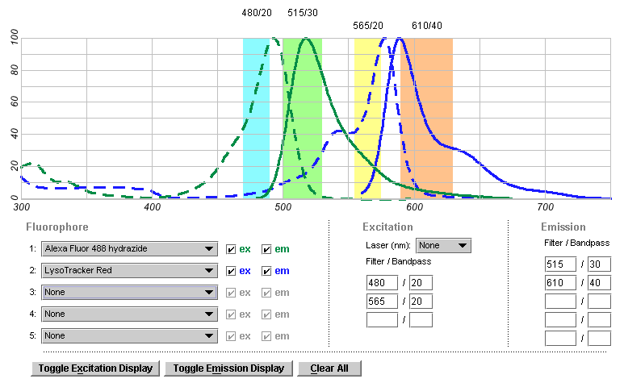
Matching Filters and Fluorophores
http://probes.invitrogen.com/resources/spectraviewer/
http://fluorescence.nexus-solutions.net/frames6.htm
https://www.omegafilters.com/curvo2/index.php

Slide 30
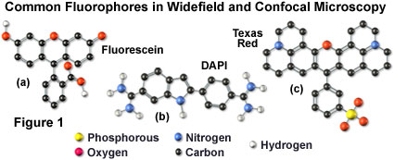
Fluorescent molecules
Systems of conjugated bonds
that share electrons
Larger system → longer wavelength
C
C
C
C

Slide 31
Parameters of fluorescent molecules
Excitation & emission maxima
Extinction coefficient ε
∝ absorption cross section
ε ≈ 50,000–100,000 M⁻¹cm⁻¹
Fluorescence quantum yield Q_{f}
= # Photons emitted / # photons absorbed
Q_{f} ≈ 25–90%
Brightness ∝ ε Q_{f}
Photo-bleaching quantum yield Q_{b}
= average # of photons emitted
per molecule before bleaching.
Depends on environment.
∝ Q_{f} / Q_{b}
I_{exc}
I_{in}
C
I_{out}
l
ε: extinction
coefficent
(M⁻¹cm⁻¹)
l: length (cm)
C: concentration (M)

Slide 32
Parameters for some common fluorophores
Dye λ_{ex} λ_{em} ε QY brightness
DAPI 350 470 27000 0.58 15.7
Fluorescein 490 520 67000 0.71 47.6
Alexa 488 494 517 73000 0.6 43.8
Rhodamine 554 573 85000 0.28 23.8
Cy3 554 568 130000 0.14 18.2
Cy5 652 672 200000 0.18 36
GFP 488 507 56000 0.6 33.6
mCherry 587 610 72000 0.22 15.8
CFP 433 475 32500 0.4 13
YFP 516 529 77000 0.76 58.5

Slide 33
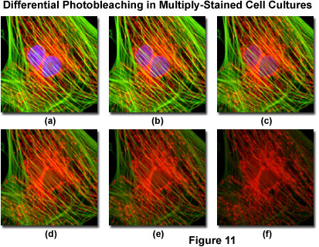
The Enemy:
Photo-bleaching
Decrease in emission intensity after exposure
Exciting a molecule once has a probability Q_{b} of killing it
Each molecule will emit only a finite number of photons

Slide 34
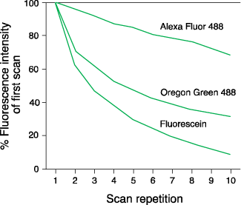
Photo-bleaching
Photostability varies between dyes

Slide 35
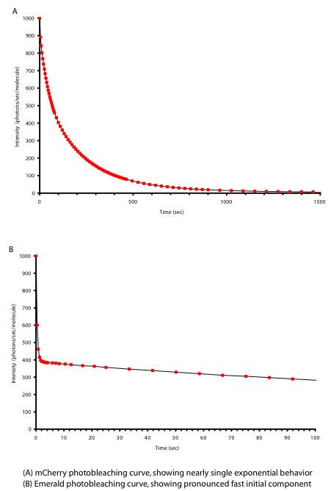
Photo-bleaching of fluorescent proteins
mCherry
Single-exponential bleaching
Photons/molecue/s
Time
Emerald
Double-exponential bleaching
Fast- and slow-bleaching populations?
Photons/molecue/s
Time

Slide 36
What to do about photo-bleaching?
Select fade-resistant dyes
Label densely
Decrease bleaching by anti-fade mounting media
Glycerol
Oxygen scavengers
Free-radical scavengers
Triplet state quenchers
Note: some anti-fade agents quench some dyes.
Budget the photons you have
Only expose when observing
Minimize exposure time & excitation power
Use efficient filter combinations
Use highly QE, low noise camera
Use simple light path

Slide 37
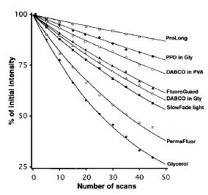
Effect of mounting medium on FITC bleaching
Ono et al. 2001, J. Histochem Cytochem. 49: 305-311

Slide 38
Effect of mounting media on Alexa bleaching

Slide 39
Fluorophore saturation
S₂
Internal
conversion
Fluorescence lifetime is ~1-5ns
Once illumination intensity is high enough to excite the fluorophore as soon as it deexcites, further intensity increases will not increase brightness
S₁
hν_{A}
hν_{A}
hν_{E}
S₀
2
1
0
Usually only a problem for confocal

Slide 40
Factors affecting overall brightness
Intrinisic brightness
Spectrum of arc lamp/lasers
Lamp/laser power
Filter set transmission
Quantum efficiency of detector
Photobleaching
Quenching / maturation / other dye-specific effects

Slide 41
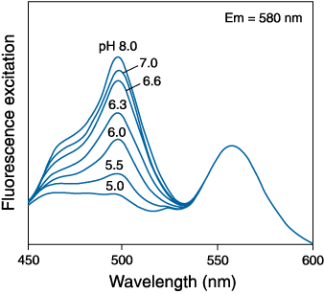
pH dependence of dyes
Mixed Fluorescein and Rhodamine
YFP variants
Fluorescein
Rhodamine

Slide 42
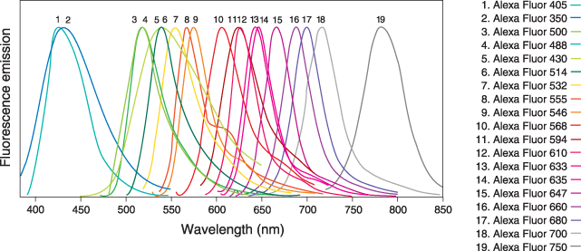
Brief discussions of various fluors

Slide 43
Traditional small molecule dyes

Slide 44
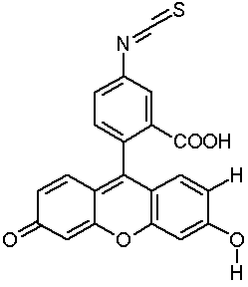
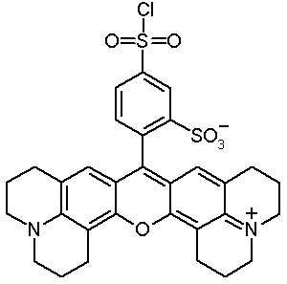
Fluorescent dyes in Biology
FITC
Texas Red
Protein labeling: couple to amino- or sulfhydryl groups
Direct and indirect (immuno-) fluorescence
Notes:
Show structure of FITC, TRITC, Cy3, Cy5
Discuss labeling strategies for proteins (targetting primary amino groups or sulfhydryls (cystein)
Explain direct and indirect immuno-fluorescence.
Show a number of images

Slide 45
Fluorescent labeling
Direct labeling (& microinjection)
of target molecules
Direct immunofluorescence:
labeled antibodies against target
Indirect immunofluorescence:
Unlabeled antibodies against target
Labeled antibodies against those antibodies

Slide 46
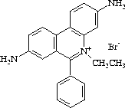
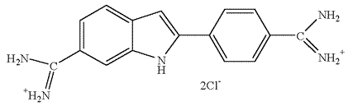
DNA Probes
DAPI
Hoechst 33258
Hoechst 33342
~20 fold enhancement
Ethidium Bromide
~30 fold enhancement
Notes:
Show structure of Ethidium Bromide (intercalation), DAPI and Hoechst 33342 (minor groove binders).
Fluorescence emission is highly enhanced after DNA binding

Slide 47
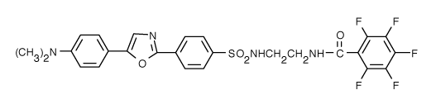
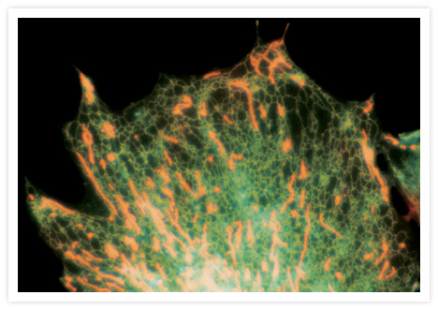
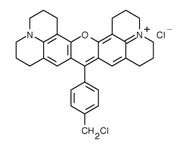
Other probes
ER-Tracker™ Blue-White DPX
MitoTracker Red CMXRos
Probes for Golgi, lysosomes, and peroxisomes are also available

Slide 48
Small molecules – pros / cons
1000s available – huge spectral range
Easy to acquire
Precisely tailored properties, including environmental sensitivity
Require fixing and staining, which can lead to artifacts
Potential self-quenching and environmental sensitivity

Slide 49
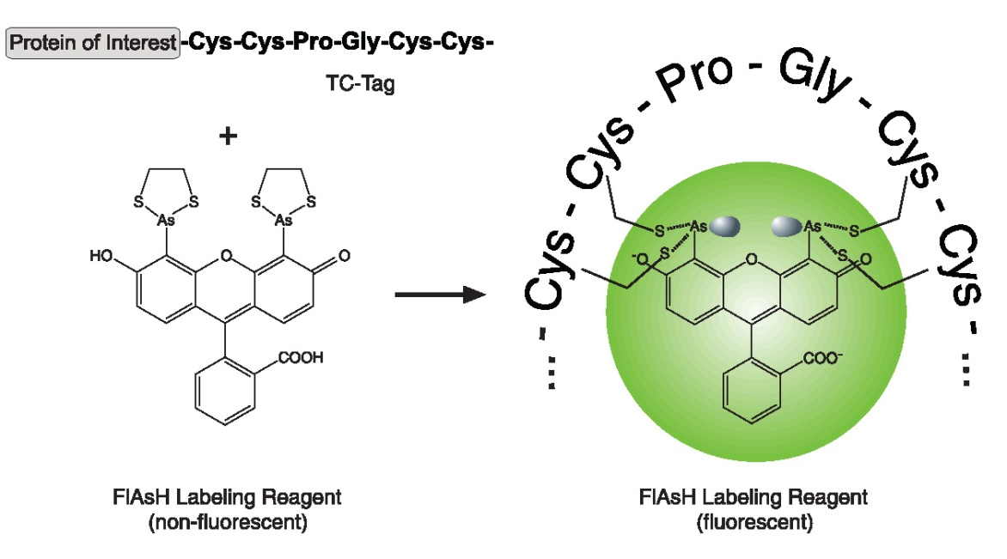
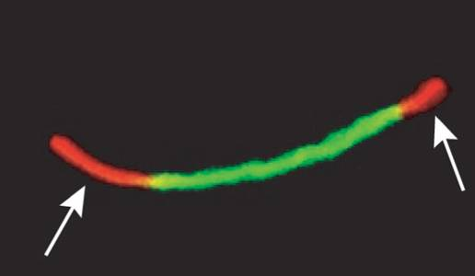
FlAsH/ReAsH
Example:
Newly synthesised connexins (ReAsH:Red) are added to the outer edges of existing gap junctions (FlAsH:Green). Gaietta et al 2002

Slide 50
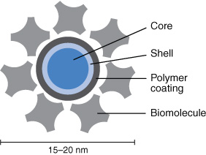
Quantum dots
“Artificial atoms” composed of small semiconductior nanocrystals

Slide 51
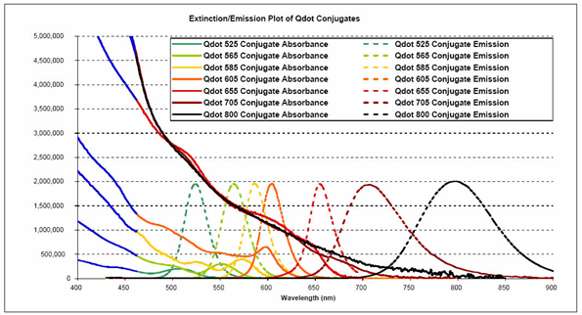
Quantum dots - spectra

Slide 52
Quantum dots – pros / cons
Little to no photobleaching
Very bright
Can use single excitation wavelength for multiple dyes
Narrow emission spectra
Large compared to small molecule dyes
Single quantum dots blink
Problems with non-specific binding

Slide 53
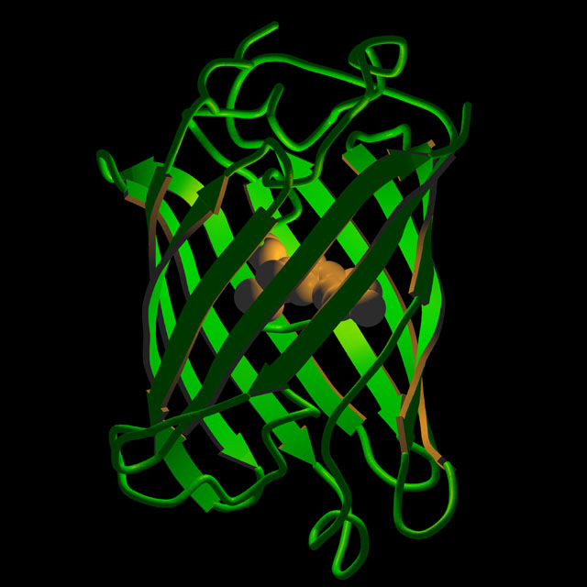
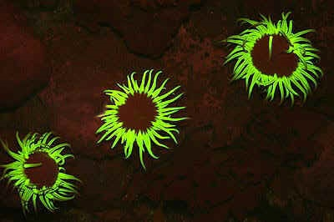
Fluorescent Proteins and Genetically Encoded Tags See future lecture!
A. sulcata

Slide 54
Resources
www.microscopyu.com
micro.magnet.fsu.edu
www.chroma.com (esp. their handbook on filter design)
www.probes.com (esp. their handbook/catalog)
Douglas B. Murphy “Fundamentals of Light Microscopy and Electronic Imaging”
James Pawley, Ed. “Handbook of Biological Confocal Microscopy, 3rd ed.”
Acknowledgements
Nico Stuurman / Mats Gustafsson / Mike Davidson

Slide 55
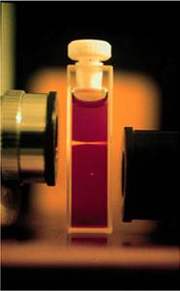
Multi-photon excitation
Internal
conversion
S₁
hν_{A}
hν_{A}
hν_{E}
hν_{A}
S₀
2
1
0
Brad Amos, MRC, Cambridge

